Slide 1
Semi-Supervised Human Action Recognition
Using Clustering and SVM Classifier
Presented by : 12A,Dept. Of CSE,ANITS Under the guidance of
318126510058 - V. Parimala G.Gowri Pushpa,M.Tech,(P.hD)
318126510059 - V. Divya (Assistant Professor)
318126510024 - K. Leela Prasad
318126510017 - G. Gopal Krishna

Slide 2
Contents
Abstract
Problem Statement
Introduction
System Approach
Feature Extraction-SIFT, Optical Flow
Building Bag-of-words Vectors
SVM classifier
Proposed Methodology
Result
Conclusion and Future Scope

Slide 3
Abstract
This project compares two different handcrafted feature extraction techniques (i.e.. SIFT and optical flow) with SVM classifier on KTH dataset. The Feature Extraction techniques extract important features from the videos. Then building a codebook using Bag-of-Words approach with the clustering technique as K-means clustering, then the classification is done using the SVM classifier. The experimental results of our approach gives an overall accuracy of 74.34% for SIFT and 84.37% for optical flow.

Slide 4
Problem Statement
As a human being, identifying human actions is a quite simple task but for a machine it is a difficult task ,and it is difficult for human beings to identify actions in large datasets but machines can process large amounts of data very easily. So if we train machines to identify the actions that are performed by humans, we can process large amounts of dataset. This project is based on Semi-Supervised Learning(training) which represents a comparison between hand-crafted methods(SIFT and Optical Flow) using clustering and SVM classifier based analysis, and discussion on these approaches.

Slide 5
Introduction
Action detection and recognition is active research area for many emerging video surveillance applications in our day today life mainly used for threat identification, monitoring.
The primary goal is to identify and recognize the action performed in a given video dynamically and labelling video with action classes.
By applying image processing and machine learning techniques, relevant features are extracted from videos and are subsequently used to model and recognise human actions
The most common approach involves two steps :
Action Representation
Action Classification

Slide 6
System Approach
Building Bag-Of-Words with K-means clustering
Training Linear SVM Classifier
Hand crafted Feature Extraction Techniques
Train
KTH
Dataset
Building Bag-Of-Words with K-means clustering
Evaluation using SVM Classifier
SIFT
Test
Optical Flow
Confusion Matrix

Slide 7
KTH Dataset
In 2004, KTH Royal Institute of Technology began working on to create a non-trivial and publicly available dataset and created KTH dataset. It is the standard dataset and contains 6 action classes: Boxing, Hand-clapping, Hand-waving, Jogging, Running, Walking and 4 scenarios: outdoor(s1),outdoor with scale variation(s2), outdoor with different clothes(s3), indoor(s4).
Each category : 100 videos (25 videos per scenario)
No. of videos : 600
Frame rate : 25 fps
Spatial Resolution : 160 * 120 pixels
File format : avi

Slide 8
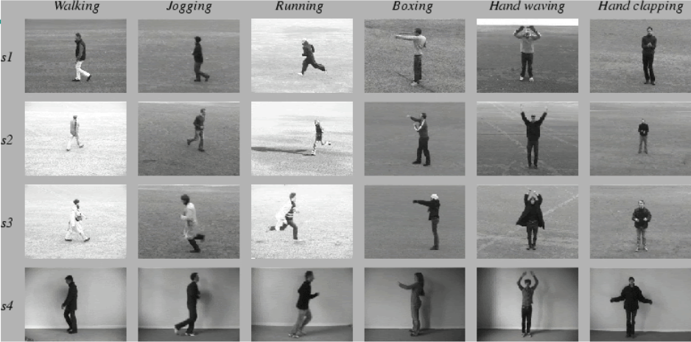

Slide 9
Feature Extraction Techniques
SIFT (Scale Invariant Feature Transform)
SIFT is a computer vision feature identification technique that was first presented in 2004 by D.Lowe of the University of British Columbia. This technique is used to locate local features in the frame known as ‘key-points’.These keypoints are invariant in scale and rotation. The major advantage of SIFT features,over edge features or hog features, is that they are not affected by the size or orientation of the image.

Slide 10
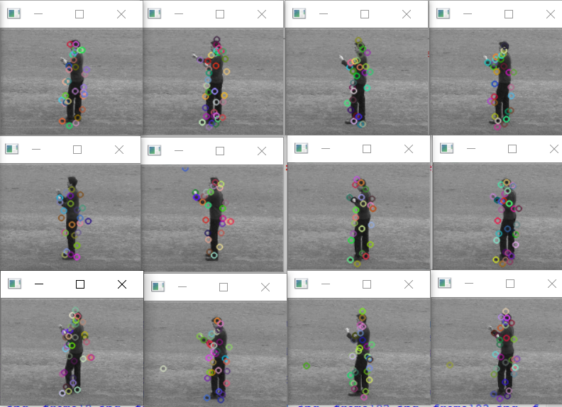
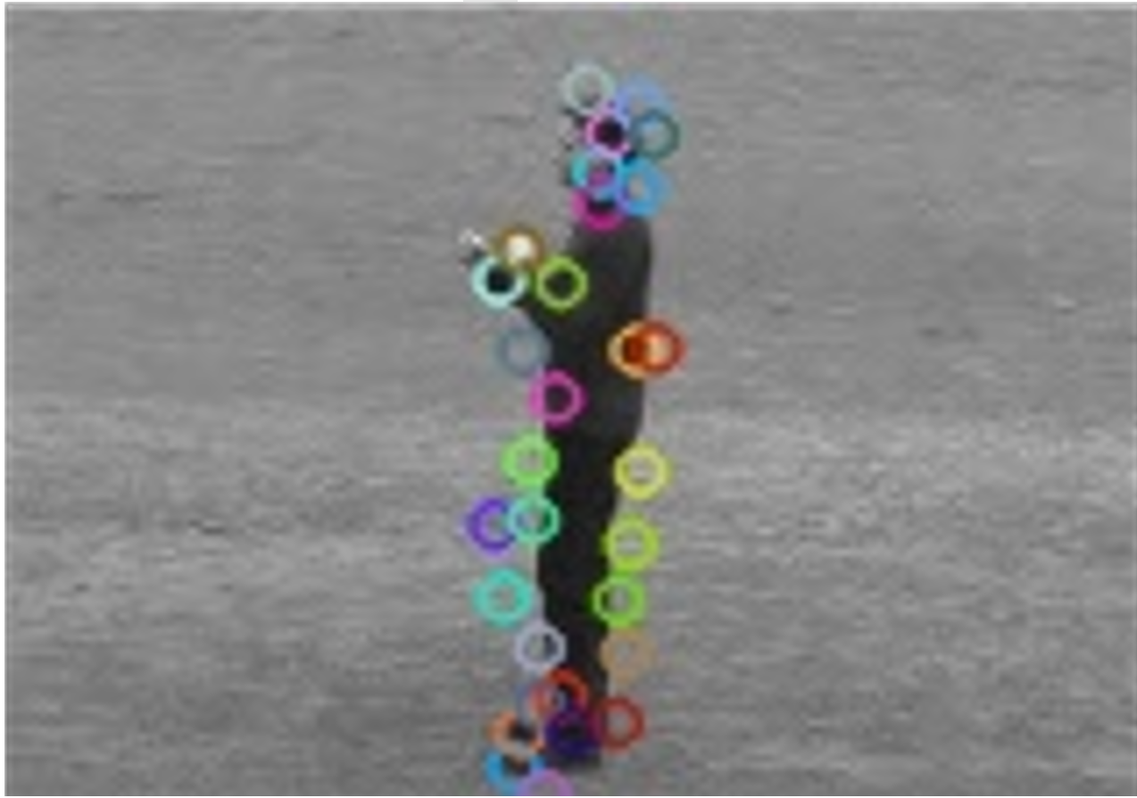
SIFT Keypoints :

Slide 11
2. Optical Flow
Optical flow technique describes the image motion. It calculates the velocity for the points in the frames. It compares the previous frame and the next frame and then computes the intensity difference among the points in the frame to pair. Once the pairing is done, it calculates the velocity by computing the distance that the point has moved.

Slide 12
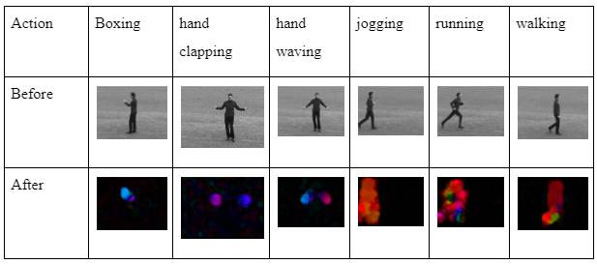

Slide 13
Bag-of-words Approach
The specific application is that after using the feature extraction algorithm, all feature points are treated as visual words.Then the k-means algorithm is used to cluster all visual words. Next we need to construct the vocabulary of the BOW model. Each image can then be represented by a multidimensional vector to facilitate later classification.
The following techniques are used in building bag of words model:
Clustering algorithm(K-means)
Vector Quantization
TF-IDF

Slide 14
SVM Classifier
“Support Vector Machine” (SVM) is a supervised machine learning algorithm that can be used for classification.It classifies the input dataset into different classes. A simple linear SVM classifier works by making a straight line between two classes. That means all of the data points on one side of the line will represent a category and the data points on the other side of the line will be put into a different category. This means there can be an infinite number of lines to choose from them it chooses the best line to classify your data points

Slide 15
Proposed Methodology
Step 1 : In the feature extraction, the video is first divided into frames and then the algorithm extracts the features from those frames.
Step 2 : These extracted features are divided into training and testing sets.
Step 3 : The key points in the training set are used to construct the clusters using K-means clustering algorithm.
Step 4 : These clusters are used build the codebook using the vector quantization and TF-IDF weighting scheme.
Step 5 : The codebook is then used to train the Linear SVM classifier.
Step 6 : The testing set is then used to evaluate the SVM classifier and the accuracy is calculated using the confusion matrix.

Slide 16
Results
Accuracy for different values of ‘k’ using SIFT:
S.No | ‘K’ Value | Overall Accuracy
1 | 10 | 26.17%
2 | 100 | 53.92%
3 | 200 | 61.25%
4 | 400 | 71.20%
5 | 800 | 74.34%

Slide 17
Accuracy for different values of ‘k’ using Optical Flow :
S.No | ‘K’ value | Overall Accuracy
1 | 10 | 31.32%
2 | 100 | 77.87%
3 | 200 | 79.16%
4 | 400 | 81.99%
5 | 800 | 84.37%

Slide 18
Comparing accuracies of each action in KTH dataset obtained using SIFT and Optical Flow techniques for 800 clusters
Method | Actions | Accuracy
SIFT | B0XING | 74%
 | HAND CLAPPING | 96.8%
 | HANDWAVING | 98.5%
 | JOGGING | 92.6%
 | RUNNING | 91%
 | WALKING | 95.5%

Slide 19
Method | Actions | Accuracy
OPTICAL FLOW | B0XING | 97.39%
 | HAND CLAPPING | 94.39%
 | HANDWAVING | 95.9%
 | JOGGING | 91.7%
 | RUNNING | 92.6%
 | WALKING | 95.8%

Slide 20
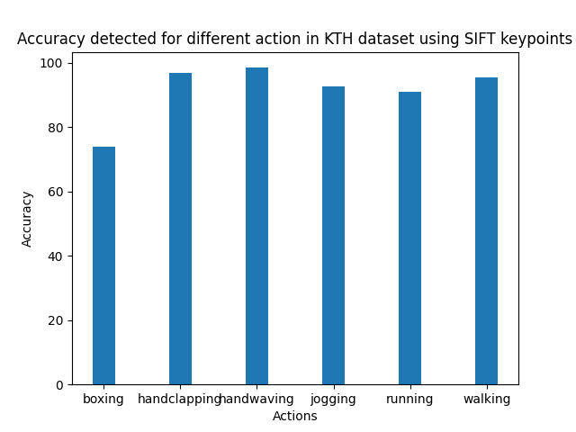
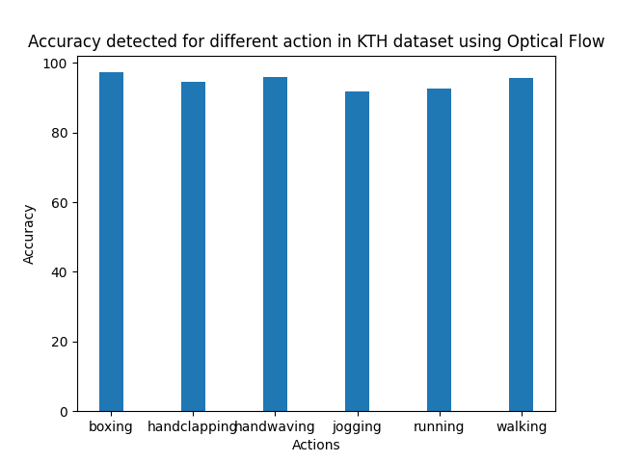
Representing Accuracies for different actions using bar graph:

Slide 21
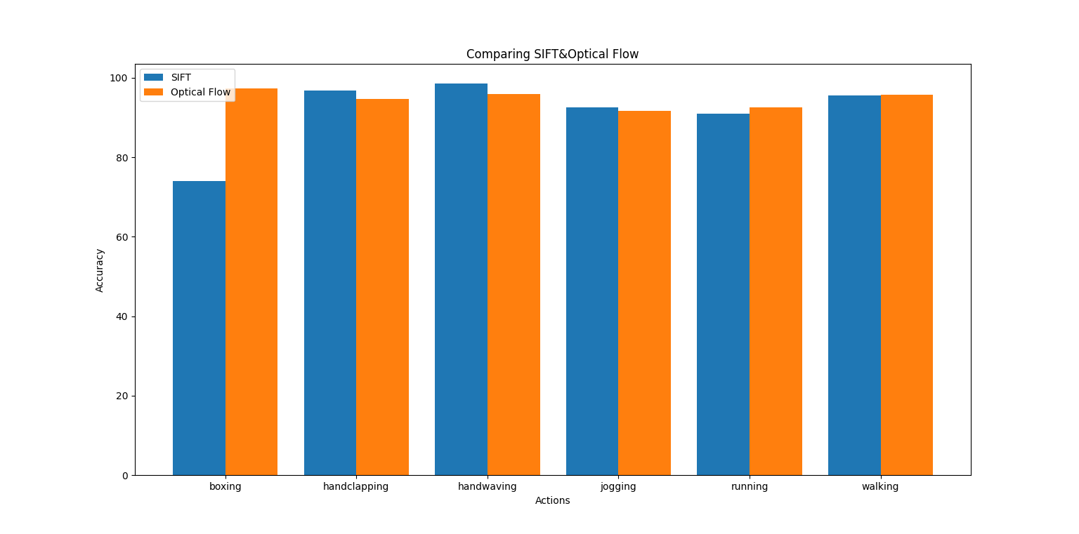
Comparing SIFT and Optical Flow Accuracies

Slide 22
Conclusion and Future Scope
Human Action Recognition proposed in this project provides an effective solution to get an idea of which feature extraction method gives the better accuracy. From the above analysis we can say that using optical flow feature extraction technique gives better results than SIFT feature extraction technique. Based on the above plots, there is much ambiguity in the action “boxing” so using Optical Flow technique the ambiguity is reduced much when compared to SIFT technique.
This scope of study will expand in future to recognize more human actions which can be used for video surveillance, to predict any malicious activities are being done.

Slide 23
THANK YOU

